Slide 1
HEART DISEASE PREDICTION
Prepared By:
Jinal Shah
Dolly Shah
Gurpreet Kaur
Tom Joseph
Pankaj Narang

Slide 2
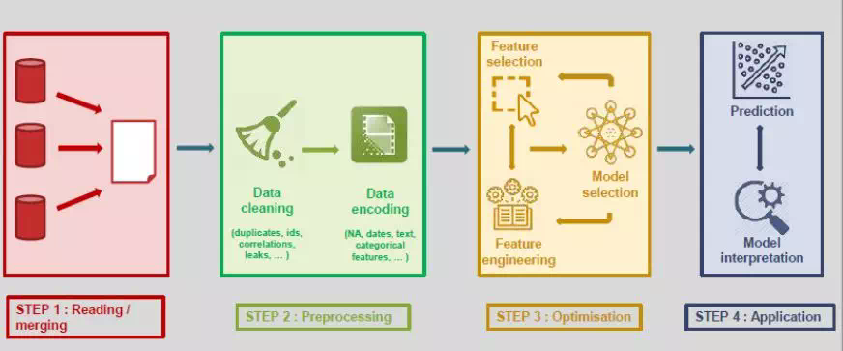
Machine Learning Steps

Slide 3
TOOLS WE USED
1.jupyter
2.Pandas
3.Scikit learn
4.NumPy
5.Scipy
6.Matplotlib

Slide 4
1.Data Preparation
1.Query Data
2.Clean Data
3.Format Data

Slide 5
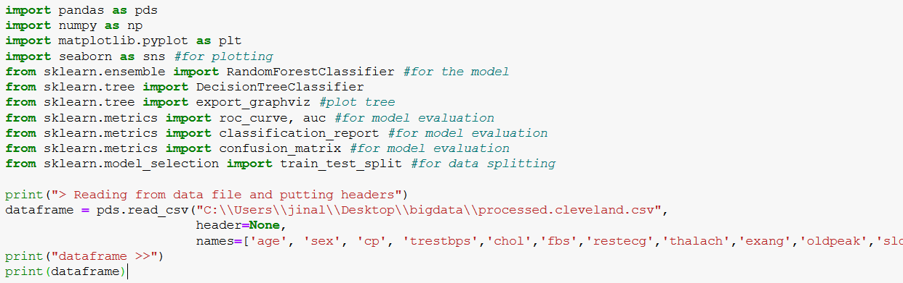
1.Data Preparation
1.Query Data
We have used Pandas library to read data and add column headers
by Querying data we get data frame:

Slide 6
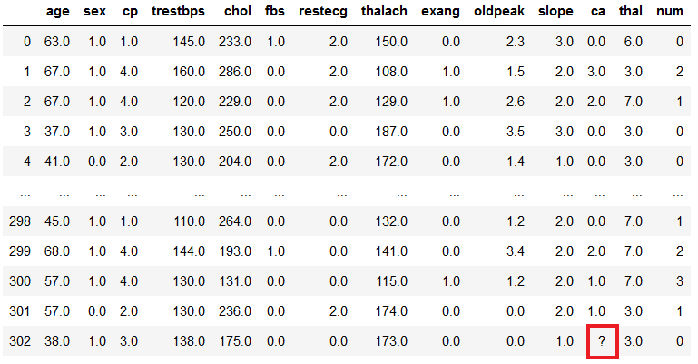
2.Clean Data
Deal with missing values
Some of column contain ‘?’

Slide 7
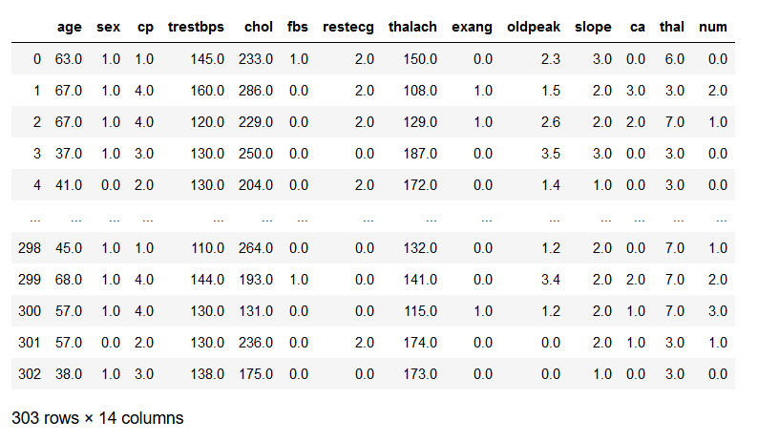
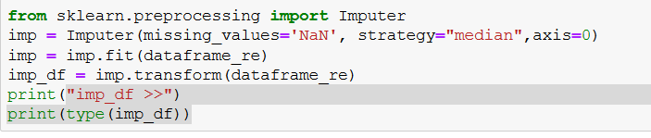
2.Clean Data
Compute ratio Rm(number of missing value/total value), is low so we use Imputer function in python.
Replace ? With NaN (Not a Number)
Filled missing value with median.

Slide 8
2.Clean Data
Remove outliers
In data frame there is some outliers. outliers mislead model so need to remove them.
1.Remove outliers arbitrarily:
Decide arbitrary threshold above which data is not have meaning.
2.use robust method:
There is some methods to remove outliers from analysis.
We have not removed any data.

Slide 9
3.Feature Engineering
Feature engineering is the process of using domain understanding of the information to create features that make machine learning algorithms work.
A feature is an attribute that might help to find solution to fix the problem.
Number of feature is called dimension.

Slide 10
3.Feature Engineering
Feature Engineering is process of transforming row data into relevant feature.
Feature should be,
1Informative:
Provides useful data to model
2Discriminative
Make difference among training examples
3Non-redundant
Does not say same thing again

Slide 11
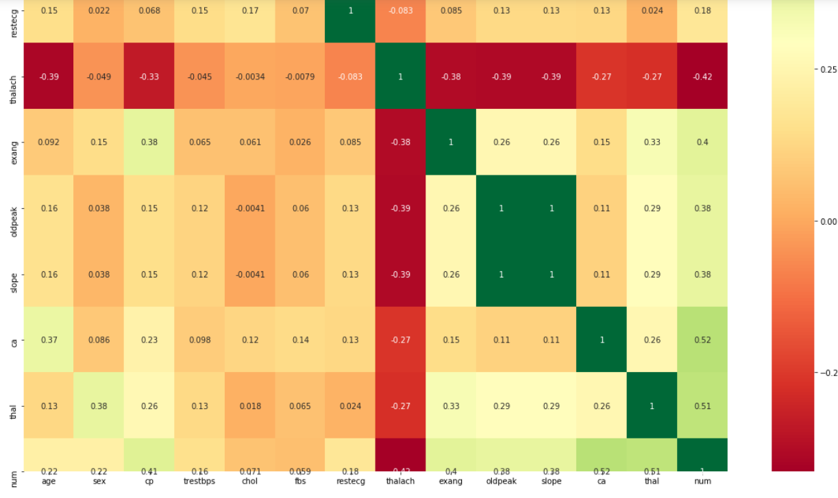
3.Feature Engineering
Dimension Reduction
we used correlation matrix with heatmap
In dimension reduction, we dropped thalach

Slide 12
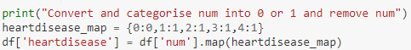
3.Feature Engineering
Feature Construction
Feature construction is the application of a set of constructive operators to a set of existing features resulting in construction of new features.
We have added a column named “heat disease” having values 0 or 1 based on “num” column.

Slide 13
Data Modelling
Supervised learning Classification
Classification problem is when your output is a category. For example, disease or no disease.
We used classification method in machine learning algorithm.
We have used a random forest classifier, which is a Meta estimator that fits a number of decision tree classifiers on various sub-samples of the dataset and uses averaging to improve the predictive accuracy and control over-fitting .

Slide 14
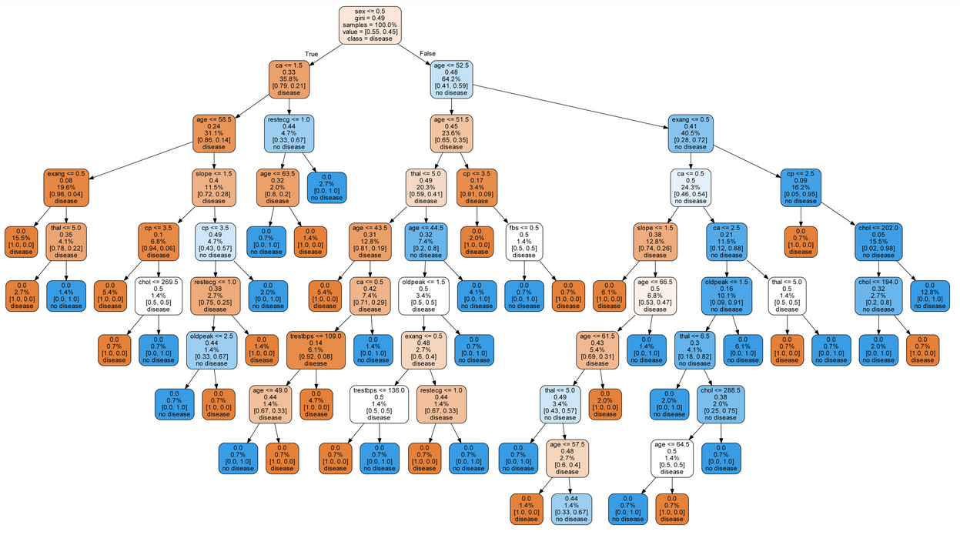
Data Modelling

Slide 15
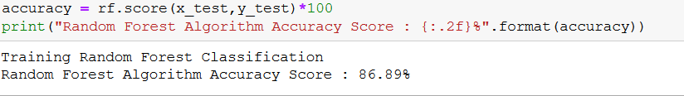
Performance Measuring
Accuracy is measured by calculating number of correctly predicted labels/total number of labels in test set.
In our model we have 86.89% accuracy

Slide 16
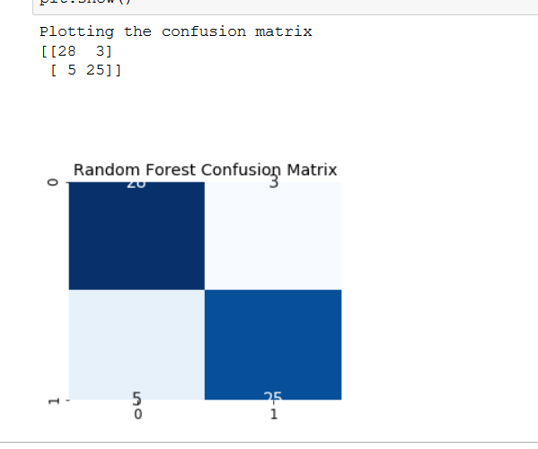
Confusion Matrix
Confusion matrix is table often used to describe the performance of classification model.
It gives insight into errors being made by classifier.
TP (True Positive)= 28
FN(False Negative)= 3
FP(False Positive)= 5
TN(True Negative)= 25

Slide 17
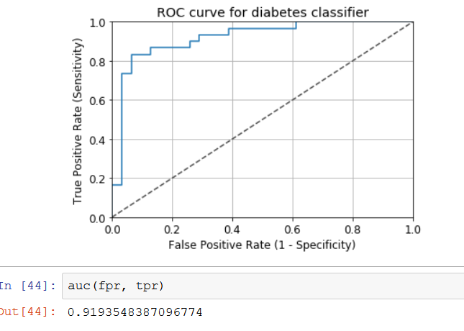
Performance Measuring
ROC Curve
In a ROC curve the true positive rate (Sensitivity) is plotted in function of the false positive rate (100-Specificity) for different cut-off points of a parameter.
Higher the AUC, better the model is at predicting 0s as 0s and 1s as 1s.
Higher the AUC, better the model is at distinguishing between patients with disease and no disease.

Slide 18
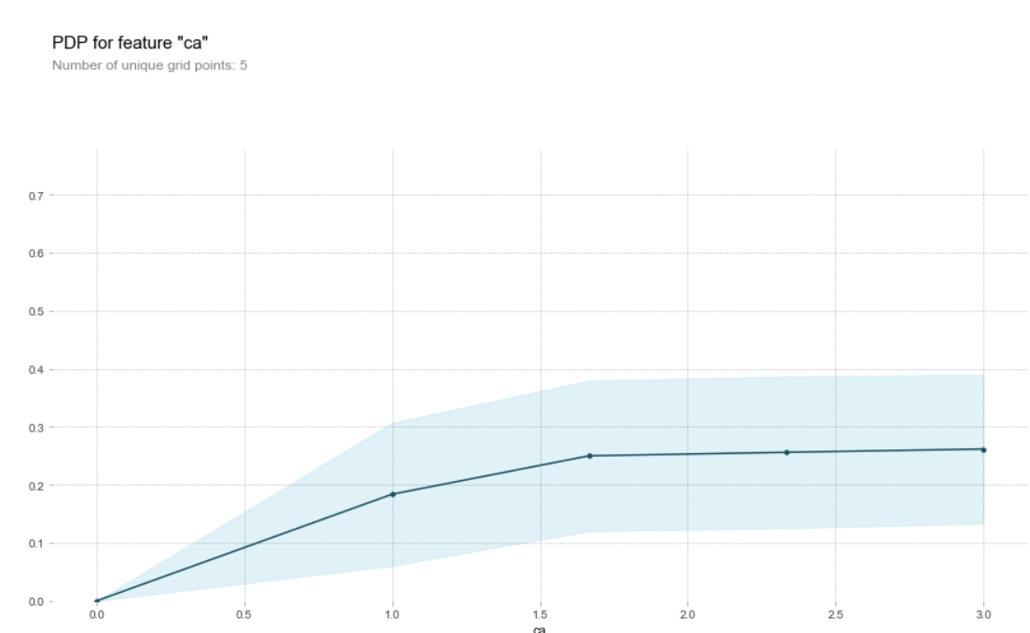
Performance Measuring
partial dependence plots for ca

Slide 19
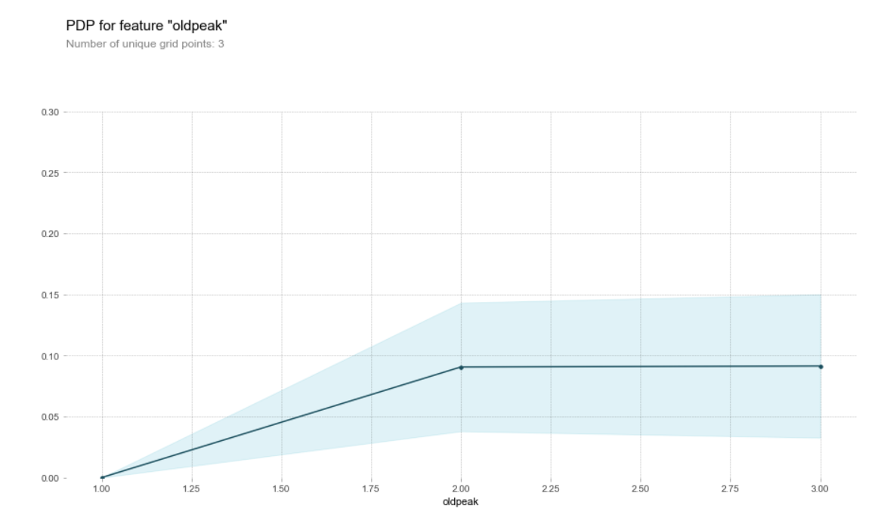
Performance Measuring
partial dependence plots for oldpeak

Slide 20
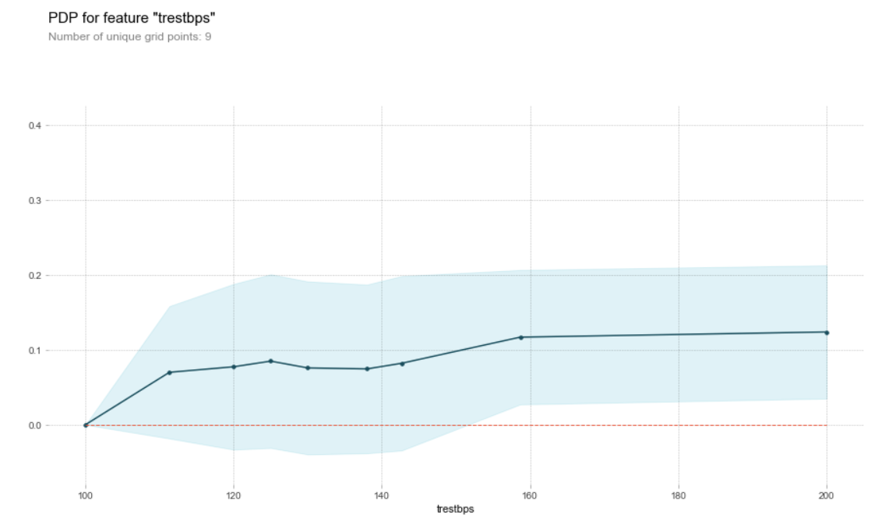
Performance Measuring
partial dependence plots for trestbps

Slide 21
Conclusion
We were able to create a machine learning model with 86.89% accuracy.
The machine-learning-based diagnosis system for heart disorder can effortlessly discover and classify people with heart disorder from healthy people and will help doctors in analyzing heart sufferers efficiently.

Slide 22
THANK YOU

